Slide 1
Precise Africa Breast(ABREAST) Ultrasound And Classfication Challenge
Team Tena, Ethiopia
Sep1,2025

Slide 2
Problem
Breast cancer is the most commonly diagnosed cancer among women worldwide, affecting millions each year.
Early detection is challenging due to subtle lesions and the difficulty in distinguishing benign, malignant, or abnormal tissue—making precise segmentation and classification essential.
Breast cancer diagnosis needs both tumor segmentation & classification.

Slide 3
Dataset and preprocessing
Used the competition dataset, did manual augmentation.
Augment dataset from BUSI source.
trained a segmentation + classification model.
split training into train/val since competition didn’t provide masks for test.

Slide 4
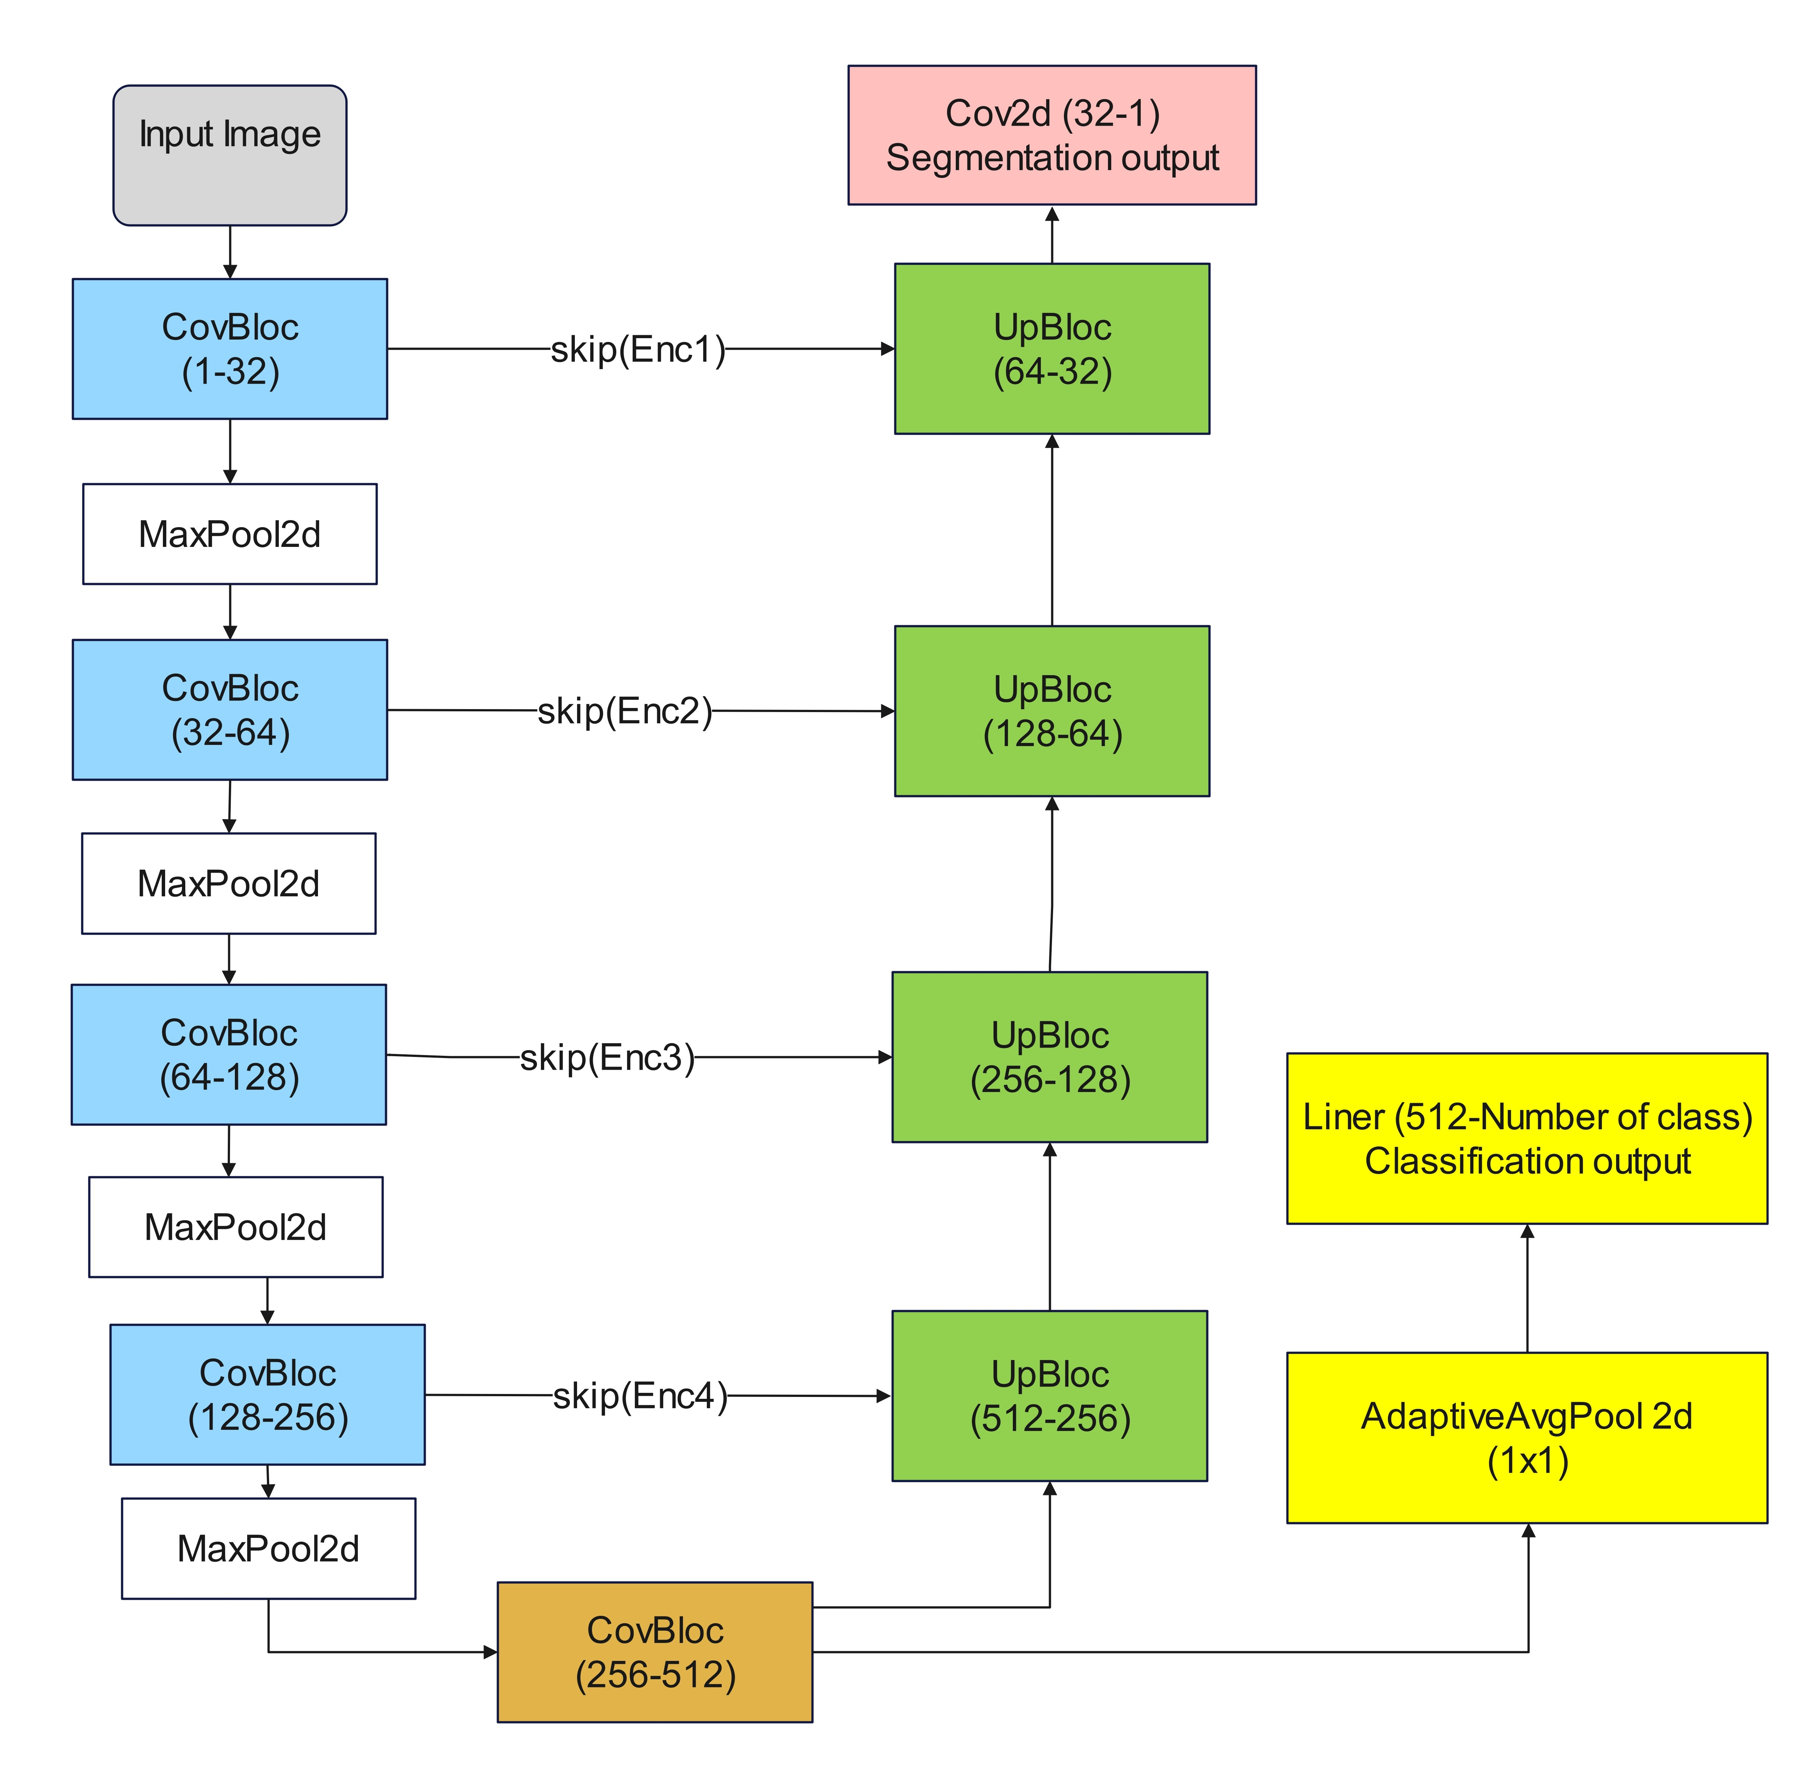
Multitask UNet Architecture

Slide 5
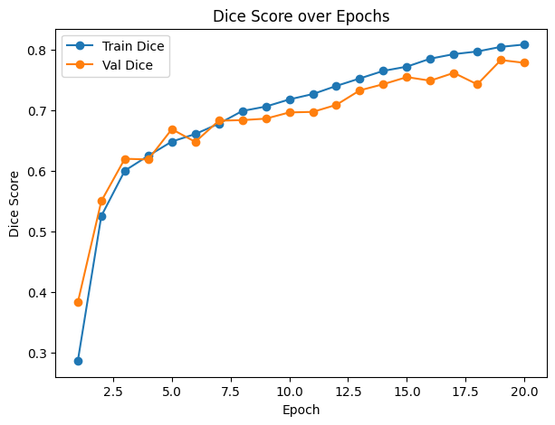
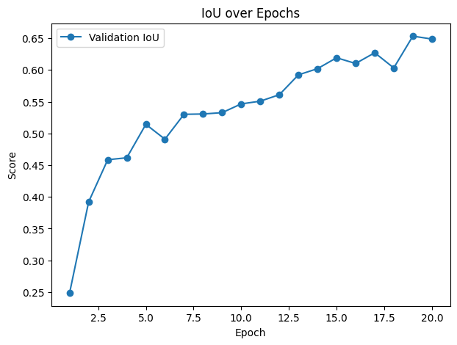
Metrics for segmntation
improvement trend (from ~0.28 Dice → ~0.78 Dice

Slide 6
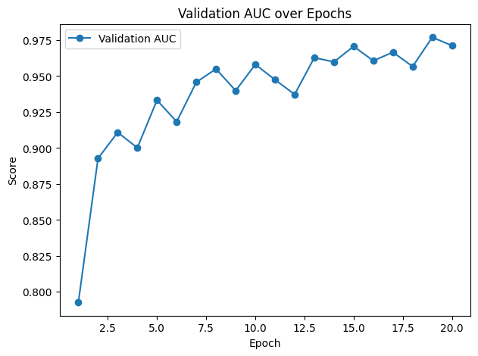
AUC For Classification
AUC ~0.79 → ~0.97

Slide 7
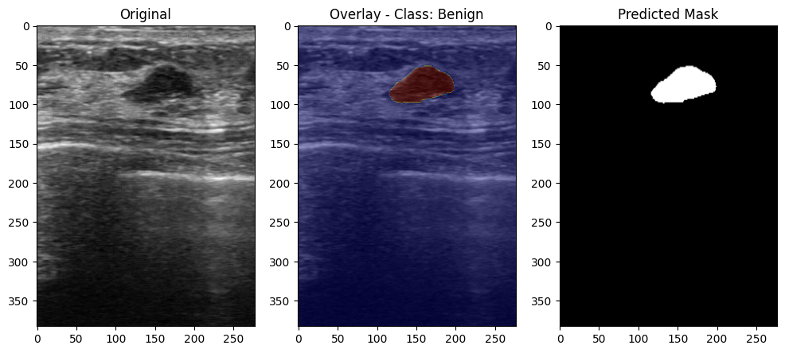
Segmenting Breast Lesions

Slide 8
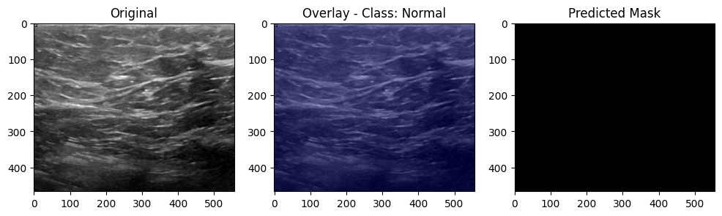
CONT...

Slide 9
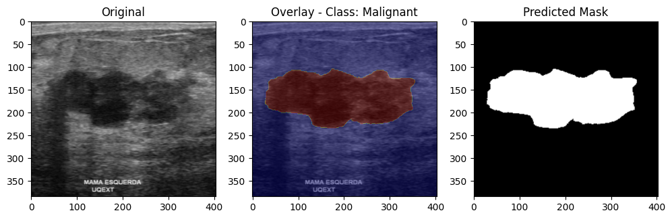
CONT...

Slide 10
Thankyou

